Slide 1
FDS Project: What makes a movie Successful?
Dorna Hamed Barghi

Slide 2
PROGRESS
Progress made so far:
Roadblocks / Challenges
Data has been cleaned and merged with second dataset for further information – namely the budget of each film to put revenue into context
I’ve looked at the correlation of all numeric values
Began the process of using k-NN to predict the success of a film
Limited dataset
Decided to also use another dataset that can provide movie budget as well as revenue

Slide 3
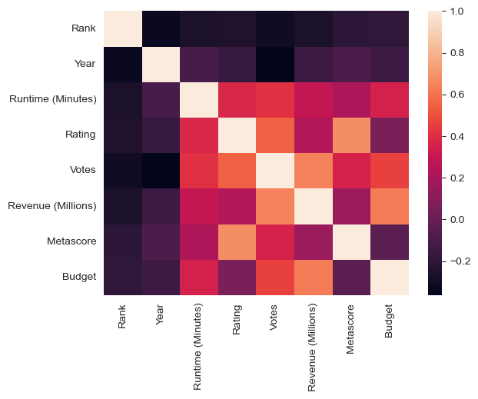
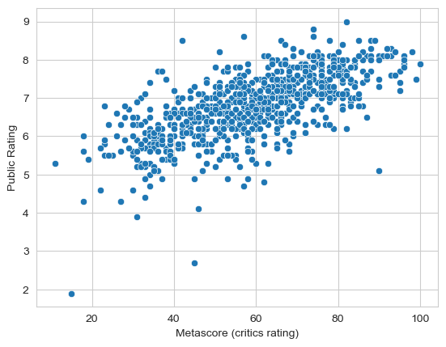
Visualisations
Heatmap of correlation of factors
Scatter plot of metascore (critics’ rating) and publics’ rating

Slide 4
Preliminary conclusion
Most important attribute
A wide audience, i.e. a film can be critically acclaimed or even well liked by viewers but if it’s not had a large enough audience (which will depend on the film’s marketing) it obviously won’t generate the same sort of revenue
Metascore
Critics and public tend to have similar opinions on a film
Measuring success
The way we measure success of a film (by revenue) is not that effective

